Slide 1
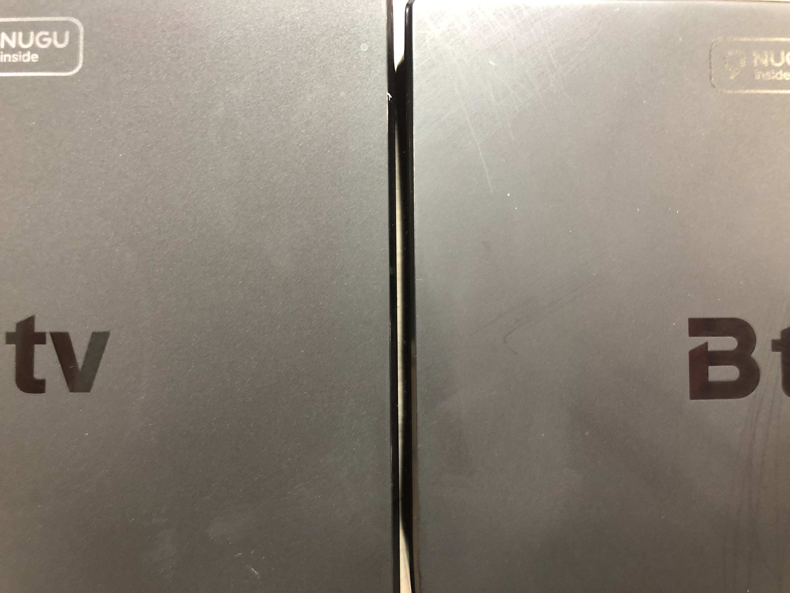
T6
T4

Slide 2
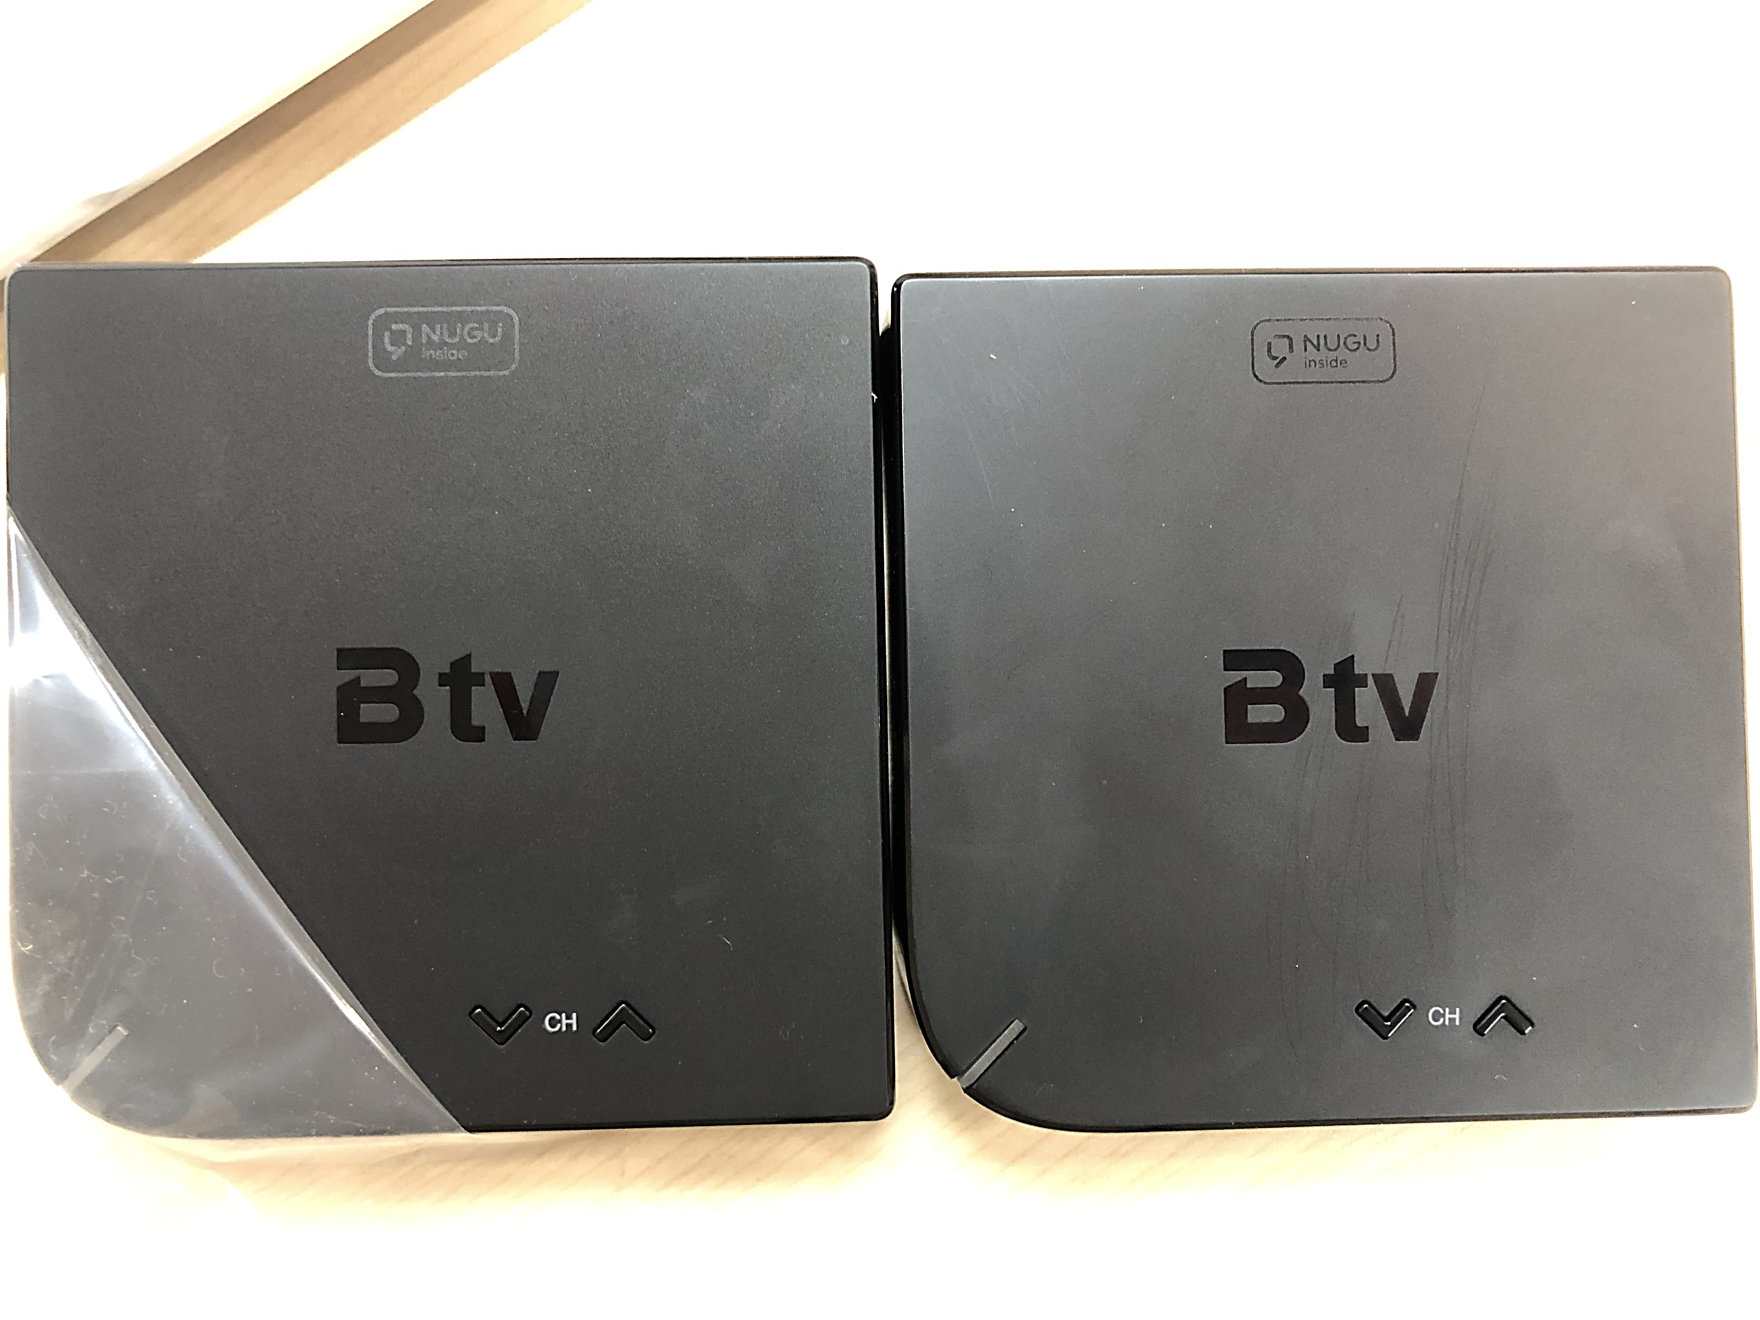
T6
T4
Gas Mark

Slide 3
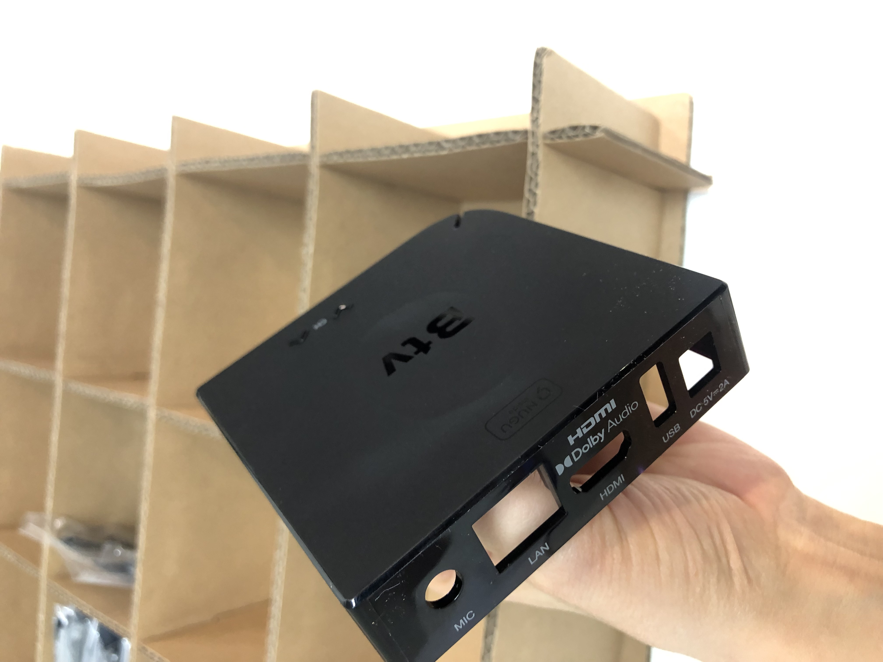
Gas Mark

Slide 4
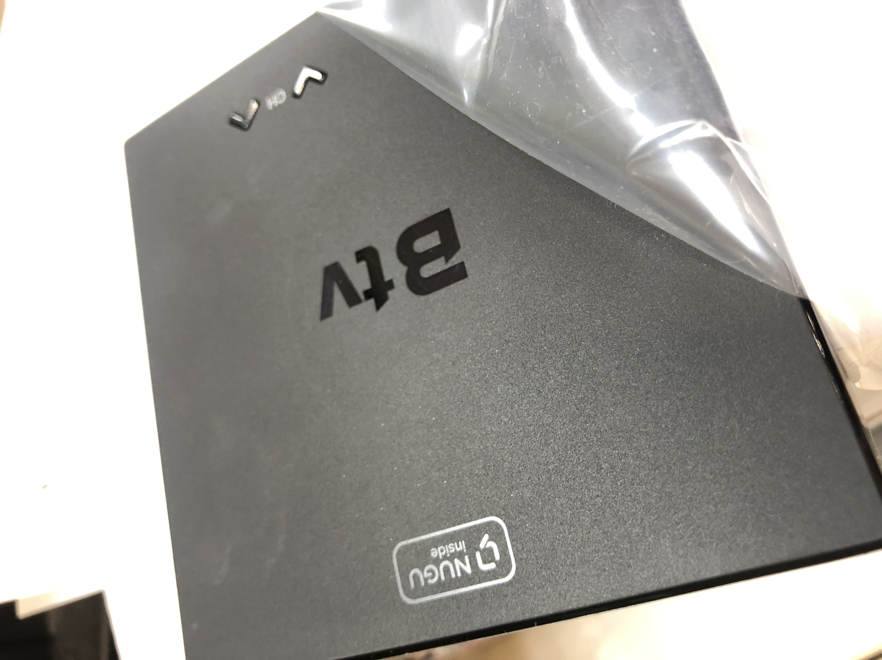
surface debris like sparkling

Slide 5
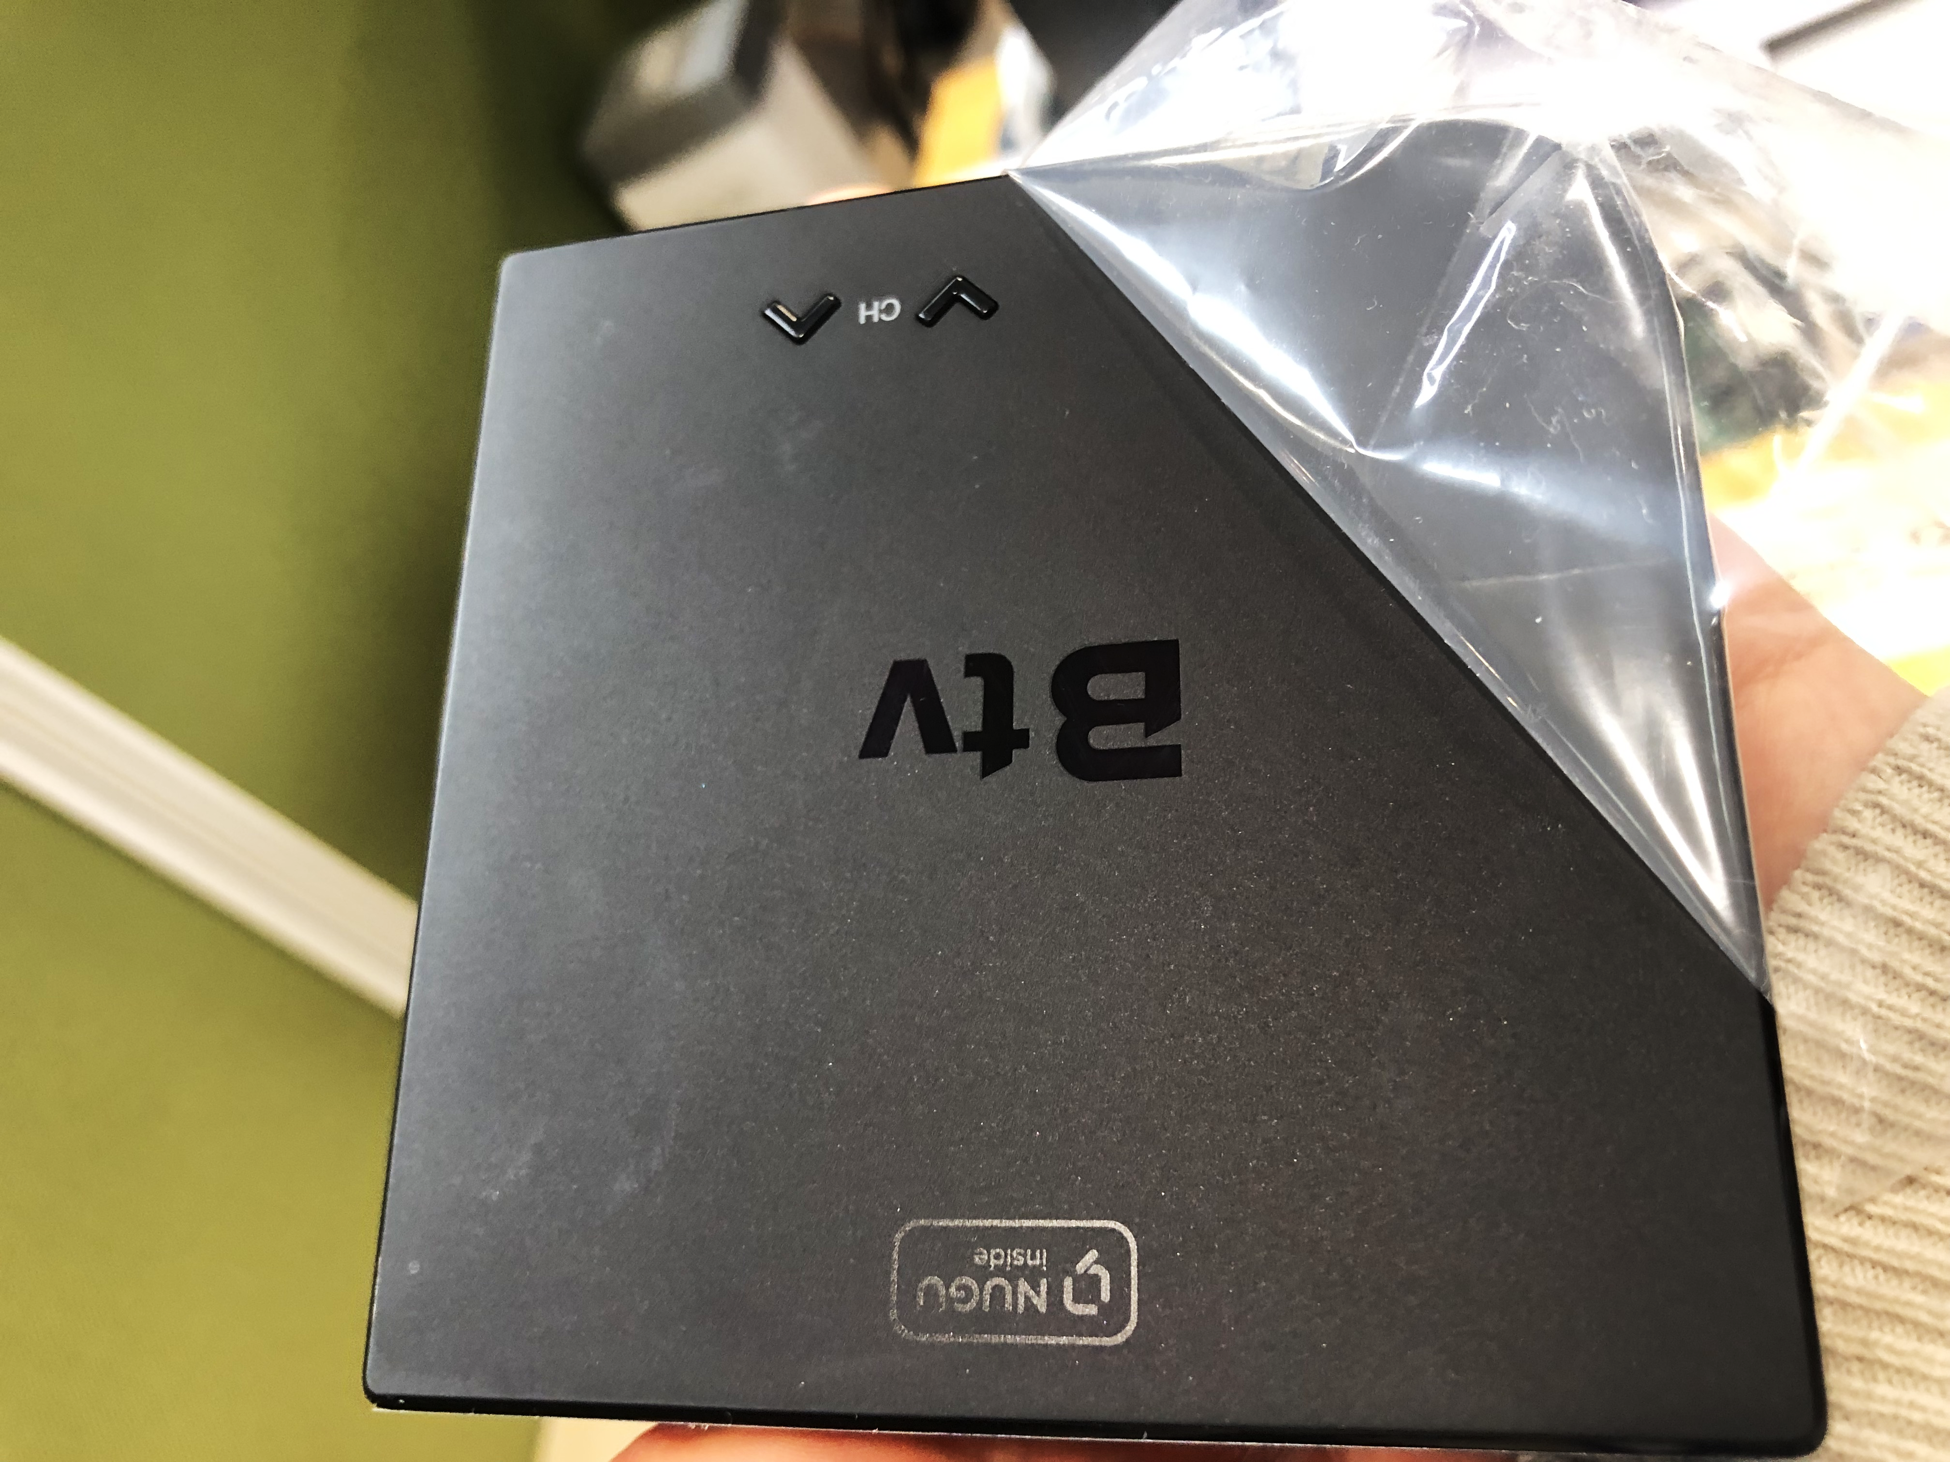
surface debris like sparkling

Slide 6
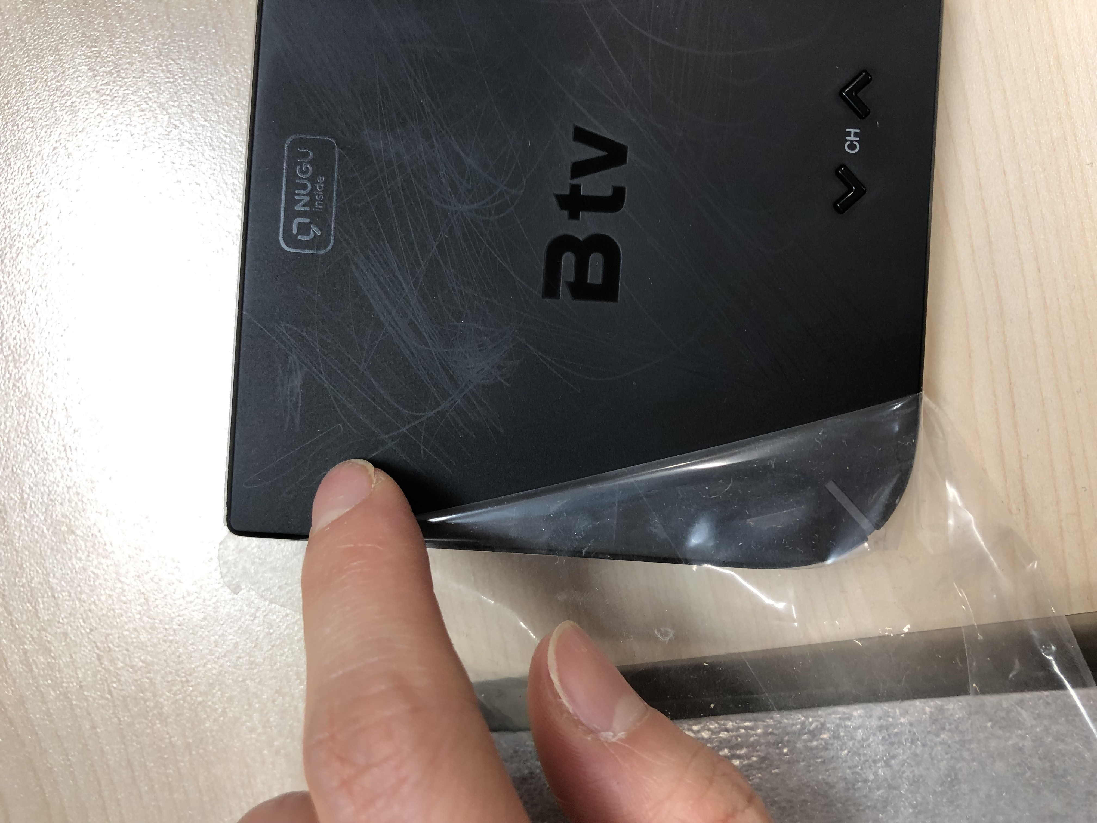

Slide 7
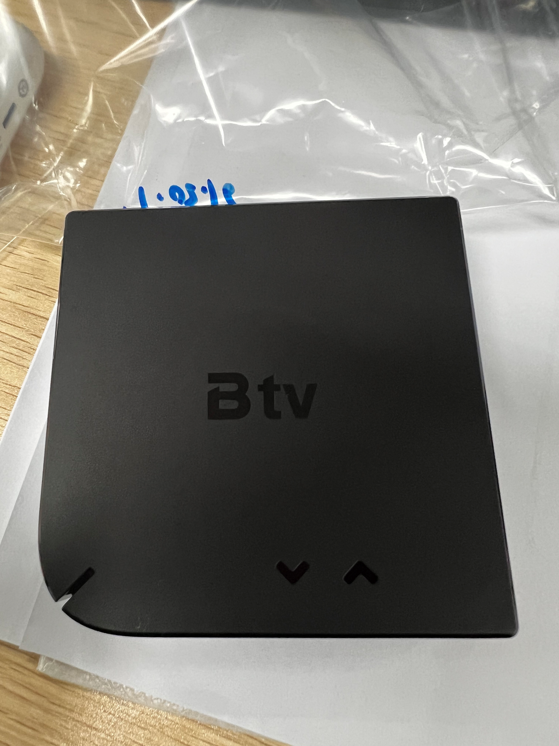

Slide 8
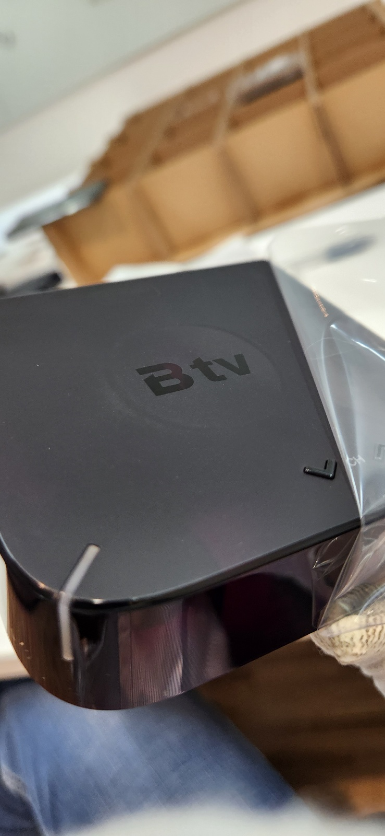

Slide 9
1. Tooling Moving
2. Housing Issue
2.1. The light emitting surface is not uniform à ALT OK
2.2. Gap between LED lens and Top case à ALT OK
2.3. Injection date code à ALT OK
2.4. The Weld Line à ALT OK
2.5. The side mark à ALT OK
2.6. The gas mark à ALT NG / It looks like getting worse. Need to improve
2.7. The surface debris like sparkling (New issue)
2.8. The top surface texture
à ALT NG / The text is changing and getting worse. We cannot approve the current status.
ALT already provided OK for T4, but now the status was changed and getting worse.

